Slide 1
Government College of Engineering, Karad Mini Project Fruit Disease Detection using Image Processing Guided by: Prof. N. M. Mule Team Members : Rani Kamble Mohsina Mulani

Slide 2
Introduction
It is very difficult to monitor the apple fruit diseases manually.
There are 3 types of apple diseases: scab, rot, blotch.
Scab apple have olive-green to black velvety spots on fruits. Apple rot infections produce slightly sunken, circular brown or black spots that may be covered by a red halo. Apple blotch is a fungal disease and appears on the surface of the fruit as dark, irregular or lobed edges.
A user-friendly software will help the farmer to some extent to detect whether the fruit is diseased or not and type of disease.
This deep learning project used for detection of diseases with more accuracy.
It is cost-effective and real-time solution to detect fruit diseases.

Slide 3
Motivation
India is an agrarian economy.
Agriculture shares 17% of the country’s GDP.
Increasing farm productivity is the need of the hour.
Annually more than one-third of the crop yield is affected by the diseases in India.
Fruit diseases can cause major losses in yield and quality appeared in harvesting.
.

Slide 4
EXISTING SYSTEMS
Several models for fruit disease identification are:
ANN, decision tree, etc.
Major concerns for these models:
Slow and inefficient algorithm
Sensitive to location of objects
Hardware dependence
Not acceptable for large data sets
Does not perform very well when the data set has more noise

Slide 5
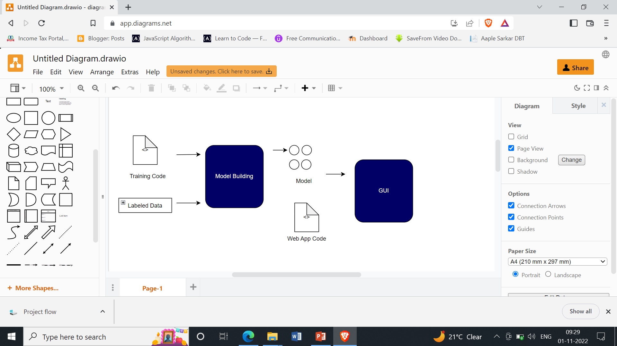
PROPOSED METHADOLOGY
Fig1. Block Diagram of Proposed Methodology

Slide 6
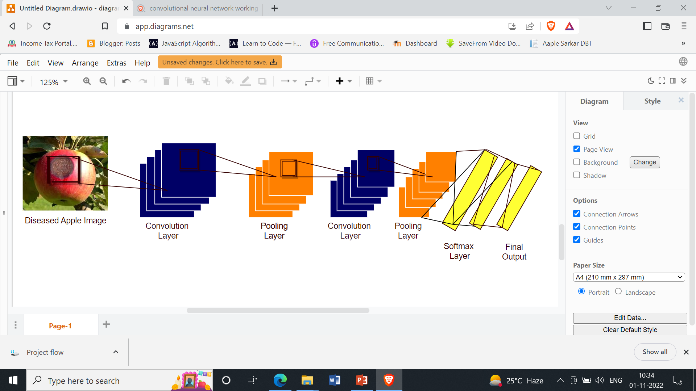
PROPOSED METHADOLOGY
Algorithm used: CNN
Fig2. Convolutional Neural Network for Apple Fruit Disease Detection

Slide 7
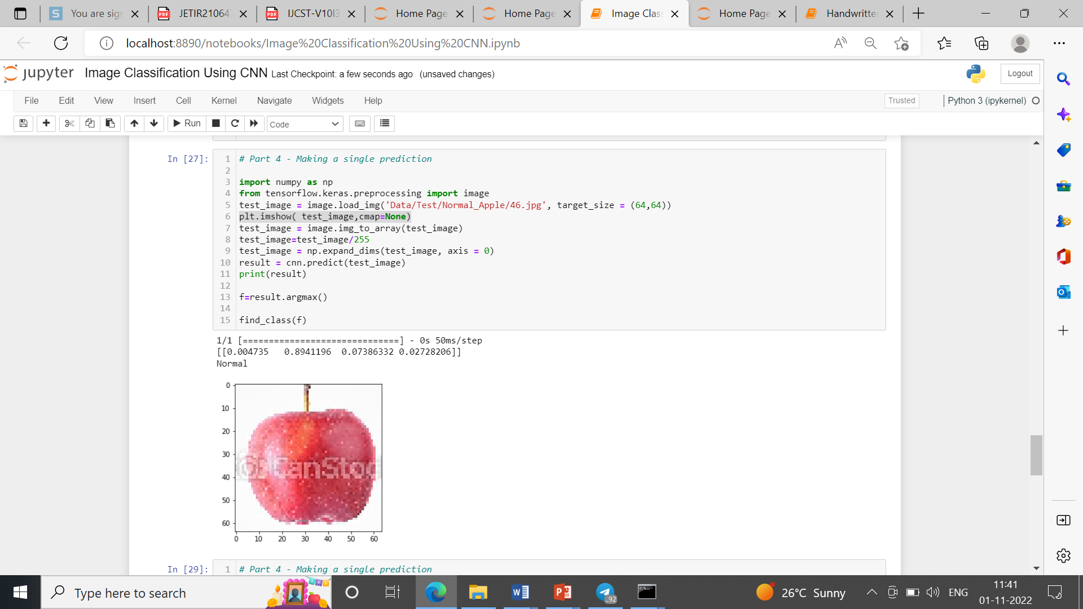
RESULT
Fig3.Normal Apple Prediction

Slide 8
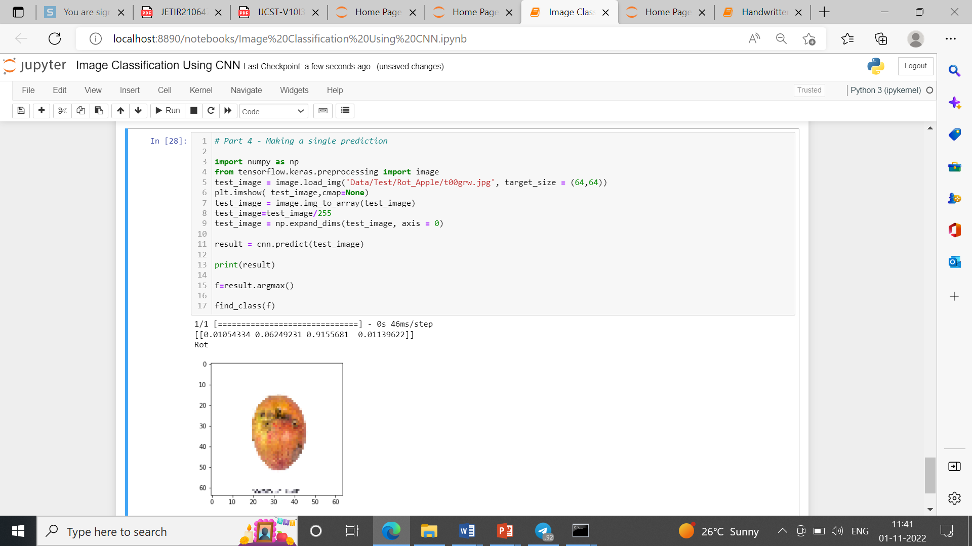
RESULT
Fig3. Rot Apple Prediction

Slide 9
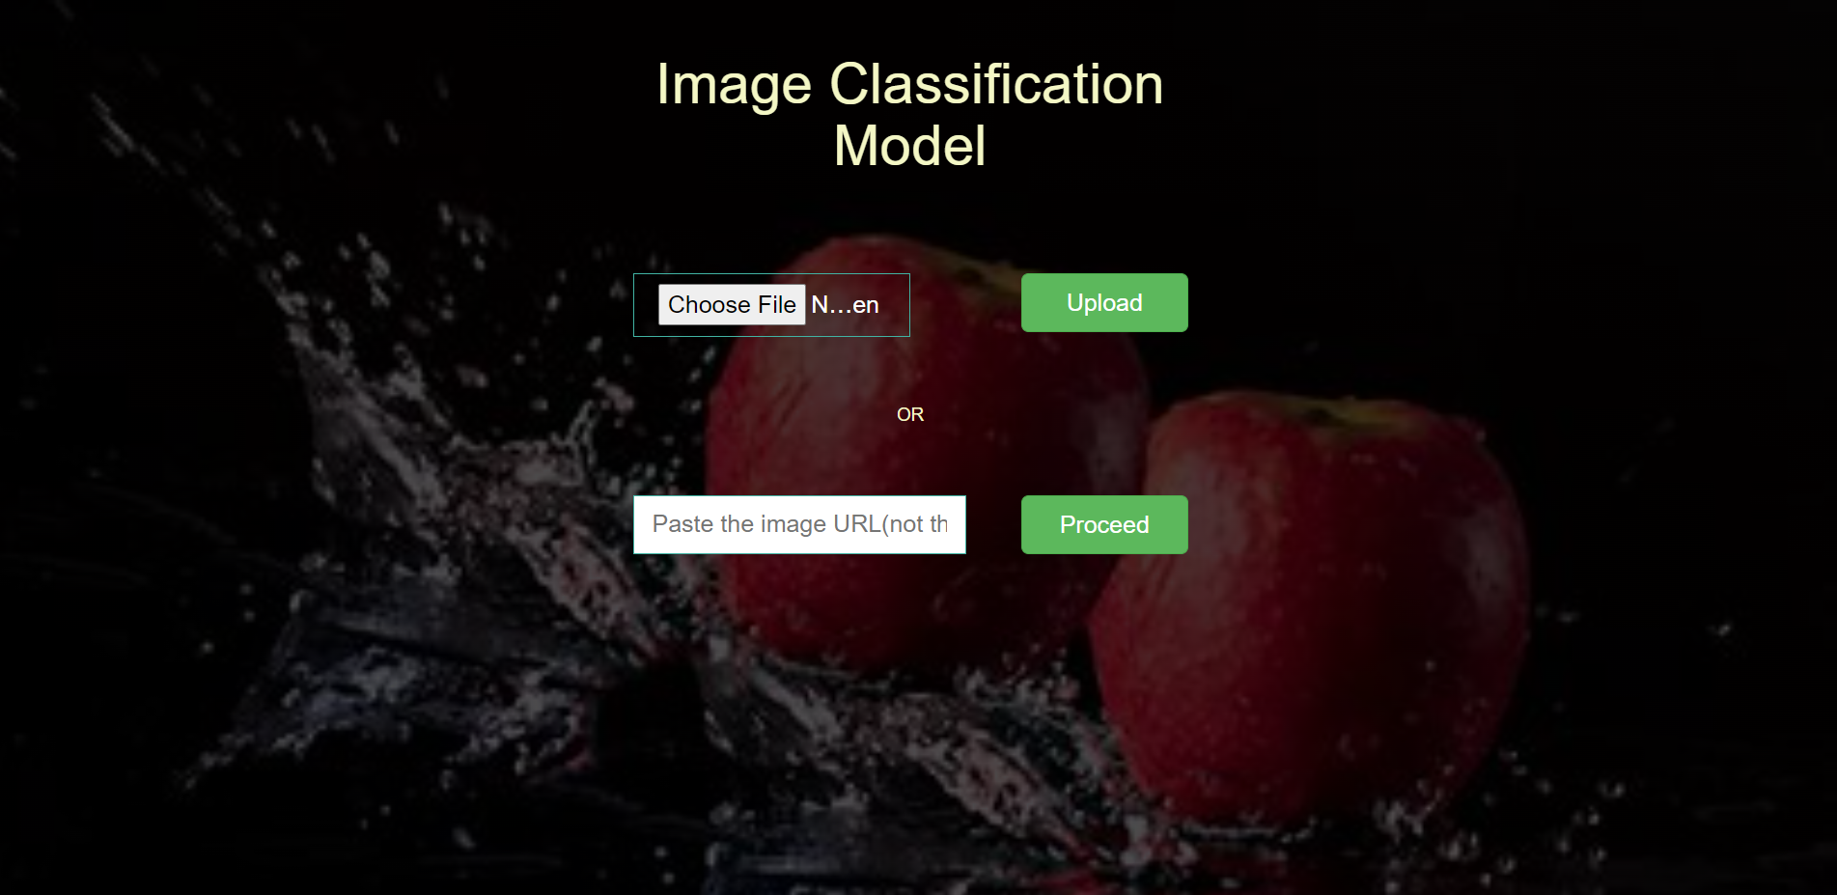
RESULT
Fig5. Home page of website

Slide 10
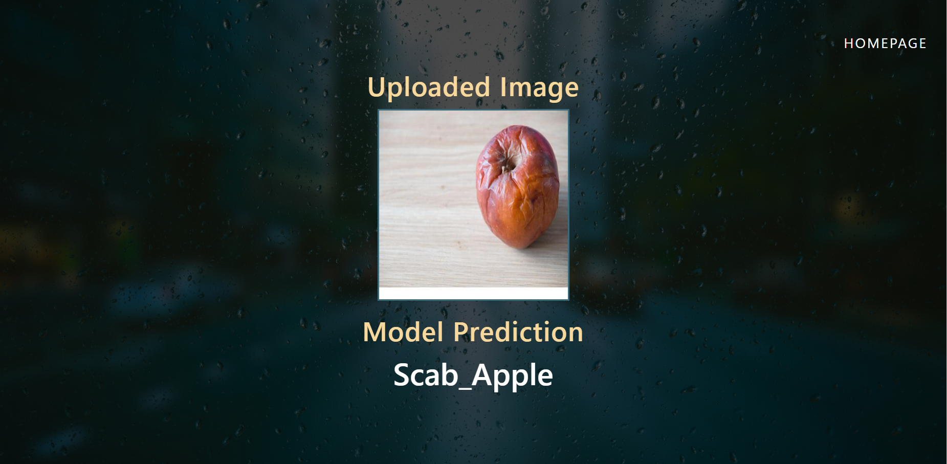
RESULT
Fig6. Final Output

Slide 11
CONCLUSION
Apple fruit disease detection can be literally achieved with the help of image processing.
The Use of CNN algorithms paves an easy way to detect the disease on the apple fruits and helps to classify the diseases of apple.
This approach can easily identify and classify the fruits using image processing techniques.
The leading objective of our project is to boost the worth of fruit disease detection.

Slide 12
Thank You!

